Slide 1

N . A . V . I Navigation. Analysis. Virtual. Innovation
Making travel easier one step at a time

Slide 2
About
NAVI leverages the power of AI to deliver the most precise traffic information available, helping you reach your destination safer and faster.

Slide 3
What is the basic idea here?
Providing easier, faster and safer routes to travel.
Predicts the nature of certain routes and the traffic in areas.
To have the knowledge of any obstruction or any accidents or accident prone areas before or after their occurrence.
To reduce the time gap that normally takes place during travel, simultaneously reducing the time duration to reach the required destination.

Slide 4
What do we provide?
Regular updates to road conditions alongside traffic conditions.
Safety alerts with regard to any road blockage or any on-going construction.
Safety alerts with regard to accident prone areas.
Safety alerts with regard to the weather forecast.
Lane-by-lane coverage.
Accurate time duration.
24/7 on road assistance.
More location coverage.

Slide 5
How does it help?
Makes travelling comparatively easier by providing convenient and shortest routes.
Improved location accuracy.
Providing routes with better and safe roads.
Substantially reducing the possibilities of occurrence of an accident or a mishappening.

Slide 6
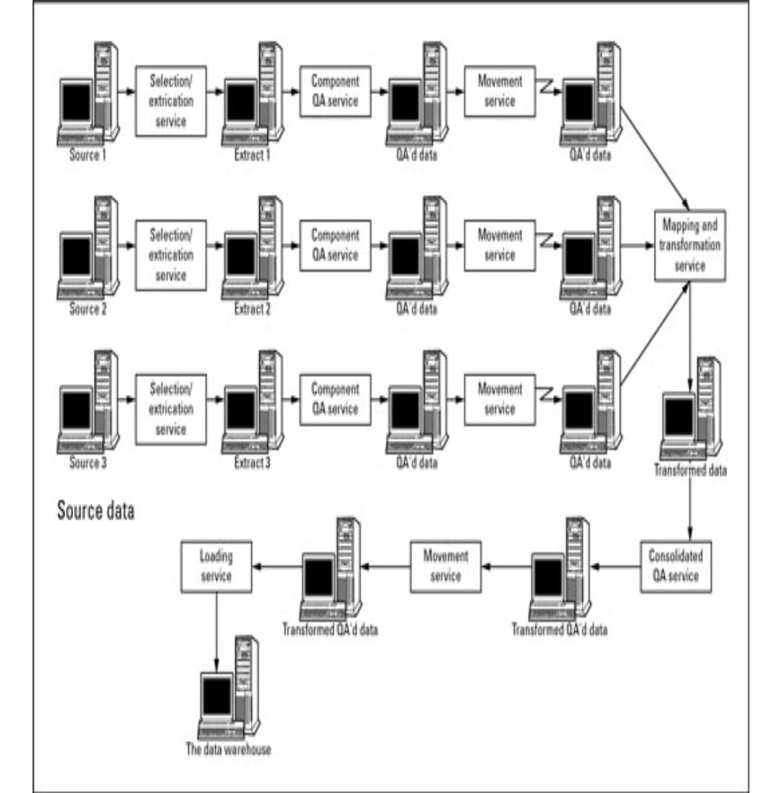
How does it function?
Fuses data collected from various sources like probe, cars and government sources
Stores and analysis the collected data on cloud providing accurate information with latency of few seconds.

